Slide 1
SUPERMARKET SWEEP
By: Troy Allen, Olivia Arneson, Mark Ramirez

Slide 2
Game Show Introduction
TV Show that ran in the 1960’s/2000’s
Two Contestants run through a store and collect items to receive a prize based on the value of items collected
Notes:
In this slide we explain what supermarket sweep is and the general gist of the game show

Slide 3
PROBLEM
SOLUTION
What is the best way to fill your cart to maximize total “cash prize”?
Finding the best path to take using optimization!
Notes:
Introduce the problem for our project and how one would plan on approaching this problem (going after the 20 most expensive items seems logical but isn’t possible due to time/distance restrictions)

Slide 4
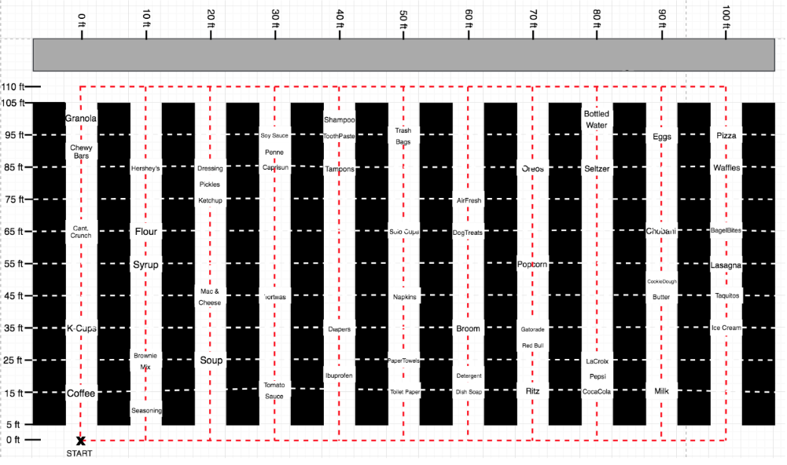
Supermarket Layout
Notes:
Talk about how you can’t just go back and forth for most valuable items, but instead how your path must be continuous after the starting point and your initial item and you must take into account time factors in order to meet 60 second constraint

Slide 5
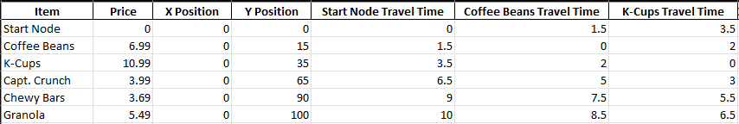
Shortest Time
To travel from item i to item j
To travel between the start/end and items
Notes:
Talk about how we calculated the shortest time by figuring out whether it was faster to go from the top of the aisle or the bottom of the aisle. You can see some examples of that in the snippet of the excel sheet above

Slide 6
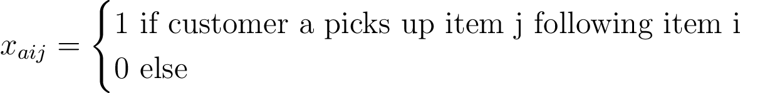
UNIQUE DECISION VARIABLES
Notes:
First set of decision vars (ours)

Slide 7
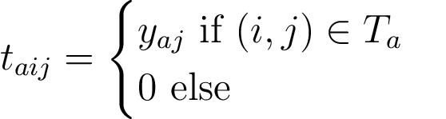
STANDARD TSP DECISION VARIABLES
Notes:
Second set of decision vars (TSP standard dvs)

Slide 8
OUR OBJECTIVE FUNCTION
Notes:
Obj func

Slide 9
UNIQUE CONDITIONS OF THE GAME SHOW
1
2
3
Shopper can not pick up more than 10 items
Shopper can only spend 1 minute (60 seconds)
Shoppers can not grab the same item as the other
4
A shopper can not grab the same item twice
Notes:
Introduce the unique conditions of the gameshow the affect our formulation of the problem (they pave the way for our constraints)

Slide 10
UNIQUE CONDITIONS OF THE GAME SHOW
5
6
7
Each shopper moves at 10 feet/s
Each item takes 2 seconds to pick up and place in cart
Each shopper must take a continuous path
8
No teleporting!
Notes:
Introduce the unique conditions of the gameshow the affect our formulation of the problem (they pave the way for our constraints)

Slide 11
10 Item Limit

Slide 12
1 Minute Limit

Slide 13
Multiple shoppers can’t grab the same items

Slide 14

Make it back to the start!

Slide 15
If you enter once, leave once

Slide 16



Standard TSP Constraints

Slide 17
What are the optimal paths?
06
Pepsi – Lasagna
Start – Diapers
01
07
Seltzer – Lasagna
Diapers – Coffee Beans
02
Ritz – Lasagna
03
08
Bottled Water – Lasagna
Coca-Cola – Lasagna
04
05
09
Milk Gallons– Lasagna
LaCroix – Lasagna
Notes:
3

Slide 18
Optimal Paths cont
06
Chobani – Lasagna
Start – Diapers
01
07
Eggs – Lasagna
Bottled Water – Lasagna
02
08
Waffles – Lasagna
Milk Gallon – Lasagna
03
Butter Sticks – Lasagna
09
Taquitos – Lasagna
04
Cookie Dough – Lasagna
05
10
Breyers Ice Cream – Start

Slide 19
What items are picked?
Lasagna Butter Sticks
Diapers Cookie Dough
Coffee Beans Chobani
Bottled water Eggs
Milk Gallons Waffles
Ritz Taquitos
Coca-Cola Breyer’s Ice Cream
La Croix
Pepsi
Seltzer
Bottled Water

Slide 20
C)
Total Value of Items = $201.83

Slide 21

How does the optimal value vary?
Opt value: 201.83
Opt value: INCREASING
Opt Value: INCREASING
Initial: 60 seconds
Increase (1): 120 Seconds
Increase(2): 180 Seconds
Notes:
Despite our answer not being complete for this segment, we can deduce that our objective value would increase a decent amount

Slide 22
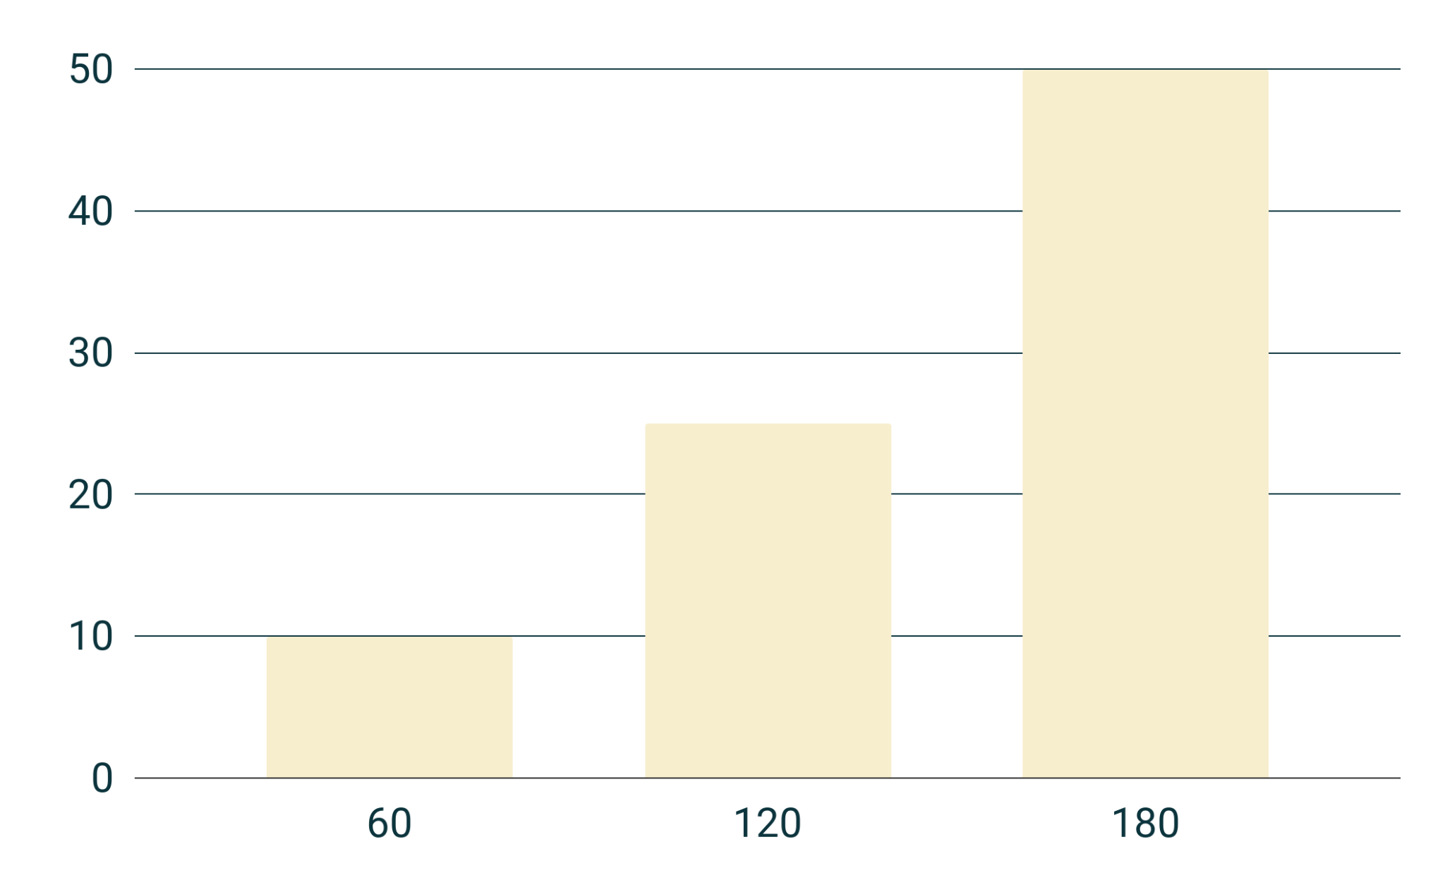
Variation in optimal value

Slide 23
What if you can’t shop together?
Sequential Shoppers
How can we formulate this?
Notes:
Introduce the problem for our project and how one would plan on approaching this problem (going after the 20 most expensive items seems logical but isn’t possible due to time/distance restrictions)

Slide 24

How to solve this
STEP 1: Run our model for just one shopper
i.e.
STEP 2: Create a new variable and constraint for our second shopper

Slide 25
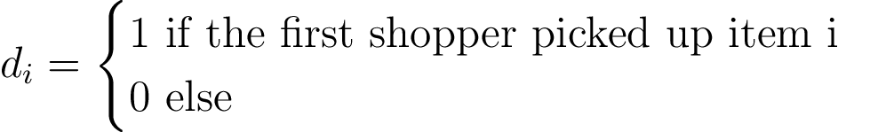
New DVs
Notes:
First set of decision vars (ours)

Slide 26
First Shopper - $95.92
06
Chobani – Lasagna
Start – Diapers
01
Bottled Water – Lasagna
02
07
Eggs – Lasagna
Milk Gallon – Lasagna
03
08
Waffles – Lasagna
Butter Sticks – Lasagna
04
09
Taquitos – Lasagna
Cookie Dough – Lasagna
05

Slide 27


Second Shopper - $13.99
Start – Diapers
01
02
Diapers – Coffee Beans

Slide 28
E)
Total Value of Items = $109.91
Notes:
Our value is wrong!

